Slide 1
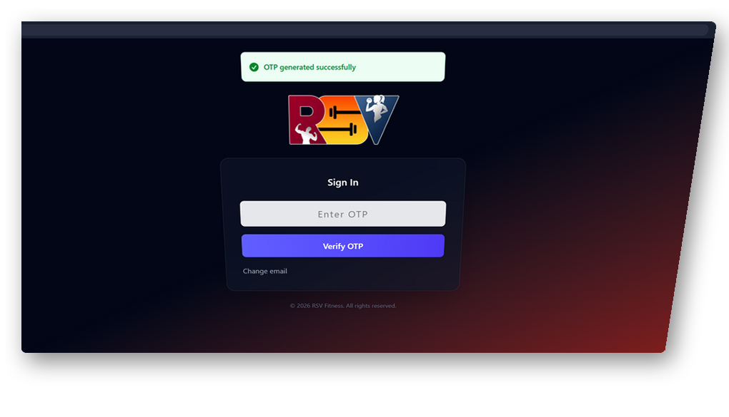
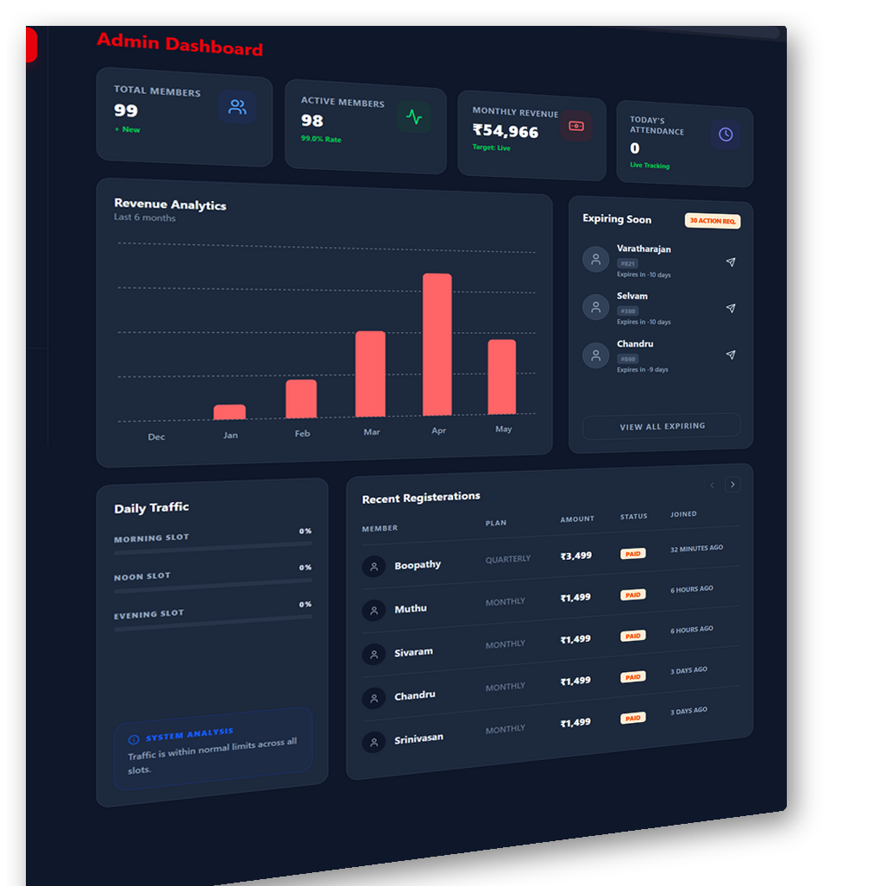
RSV FITNESS
STUDIO
Gym Management SaaS Platform
A premium, all-in-one solution for modern fitness
centers — built on Next.js, secured with JWT,
and optimized for Netlify hosting.
Next.js
TypeScript
MongoDB
Netlify
i18n
99+
₹54K
QR
2
Members
Revenue/mo
Attendance
Languages
Confidential Client Presentation • RSV Fitness Studio • 2026

Slide 2
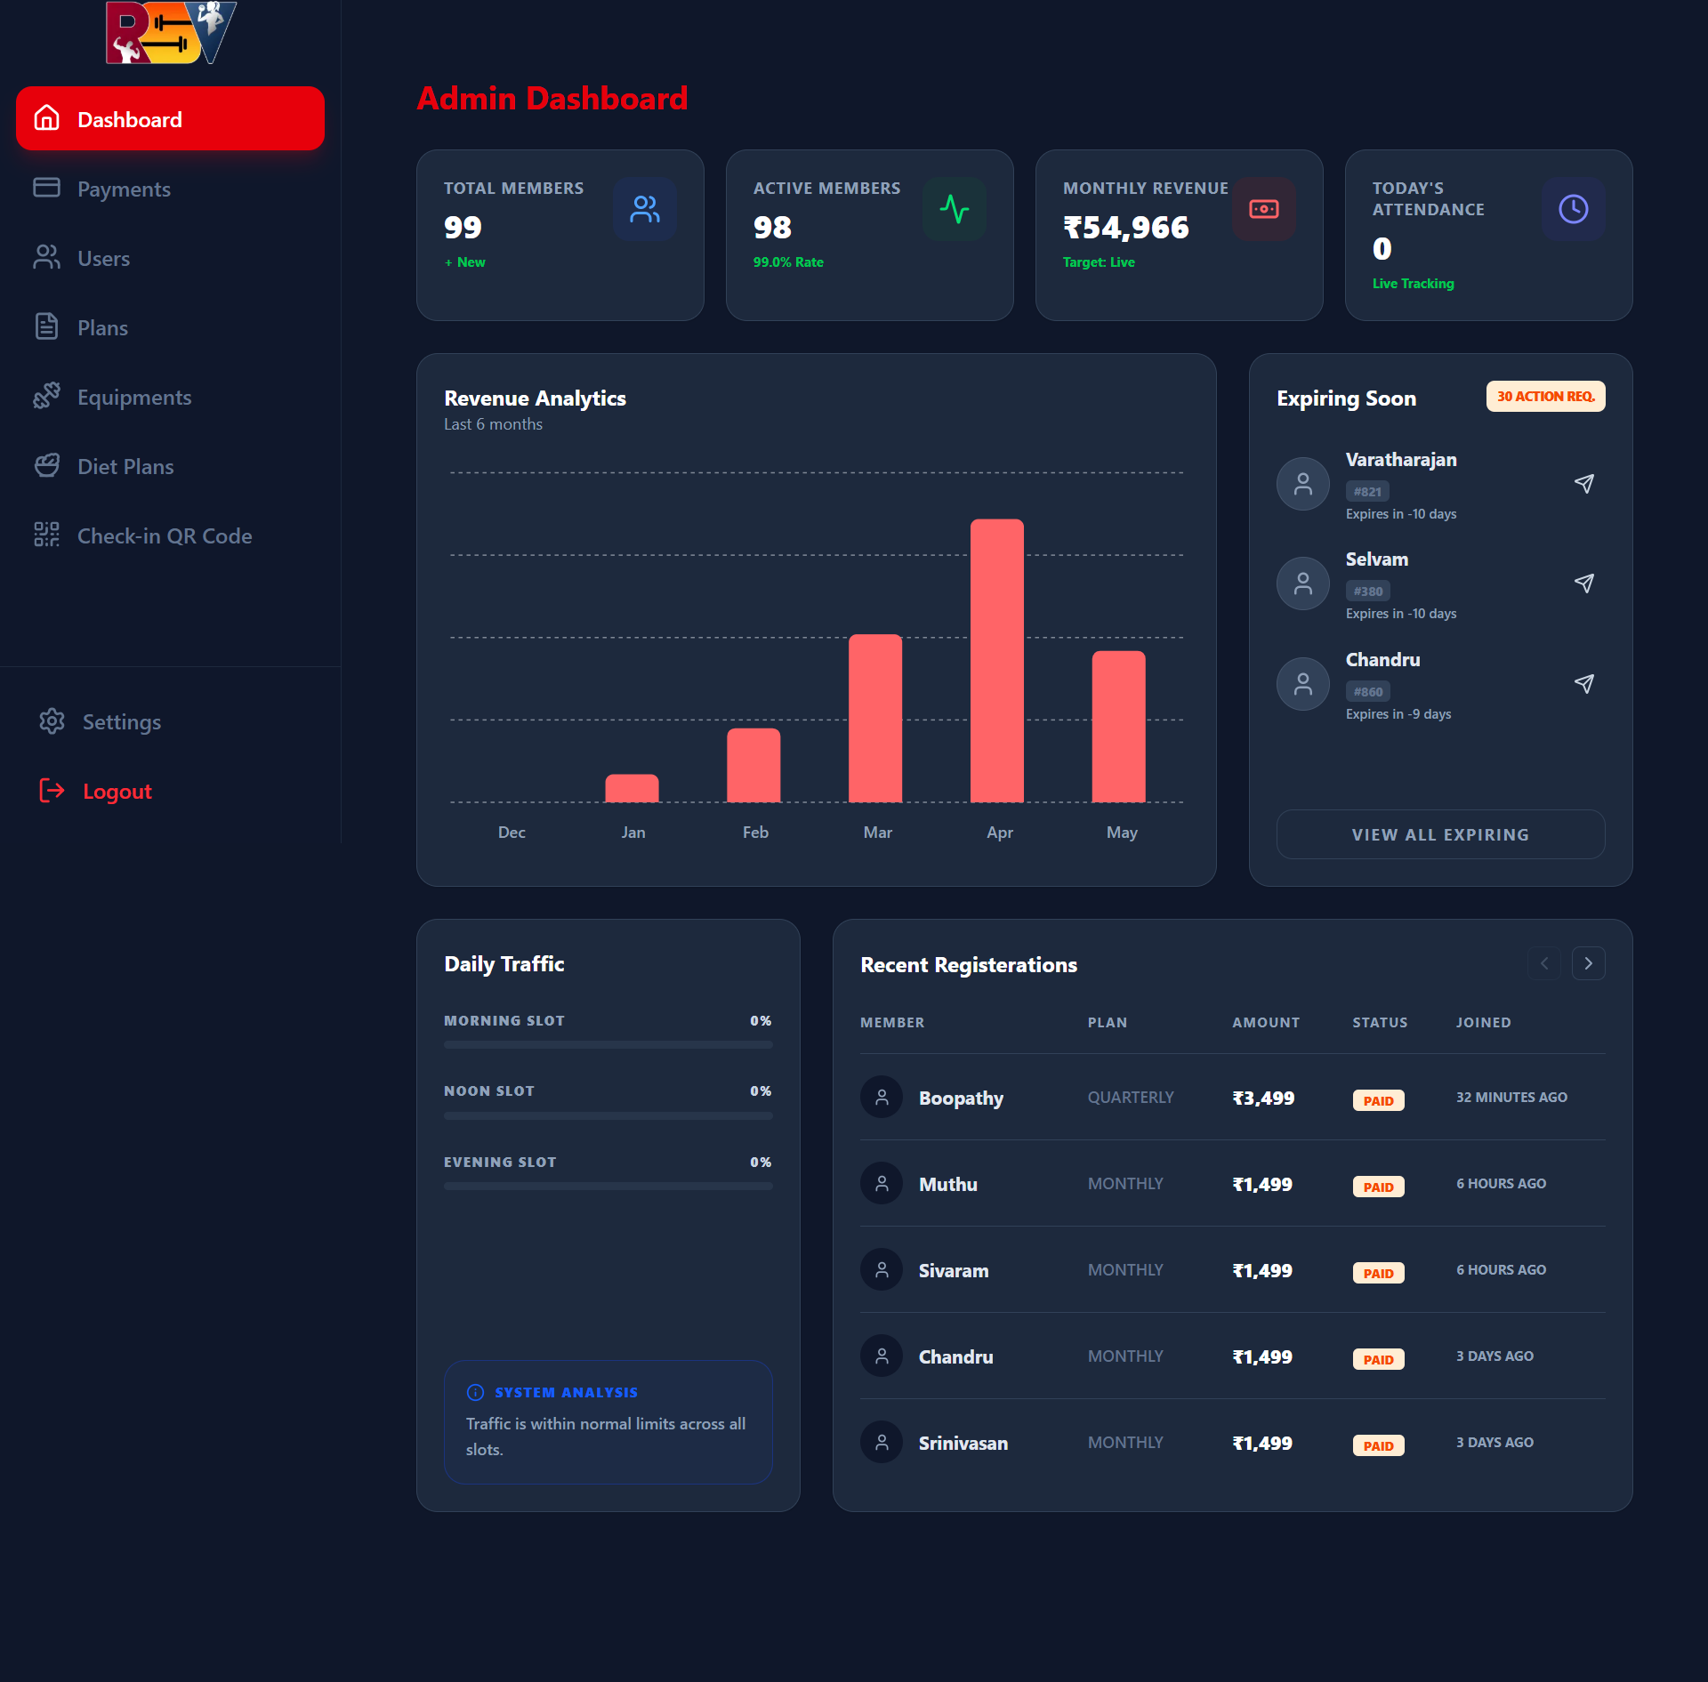






PLATFORM OVERVIEW
Everything Your Gym Needs
🖥 Admin Dashboard — Live Preview
One platform. Every feature. Zero complexity.
RSV Fitness Studio brings together member registration, QR attendance, payments, diet & workout plans, equipment tracking, and analytics — all in a single, role-based SaaS application.
Admin Dashboard
QR Attendance
Real-time KPIs: members, revenue, attendance & expiry alerts
Touchless check-in via QR scan. Duplicate prevention built-in.
Member Manager
Payment Tracker
Register, edit, track status, assign trainers & download profiles
Track plans, generate PDF invoices, view payment history
Diet & Workout
Equipment
Create & assign personalized diet + workout plans to members
Track gym equipment & maintenance status in real-time
Role-based access: Super Admin • Admin • Member • Built for scale on Netlify Hobby

Slide 3
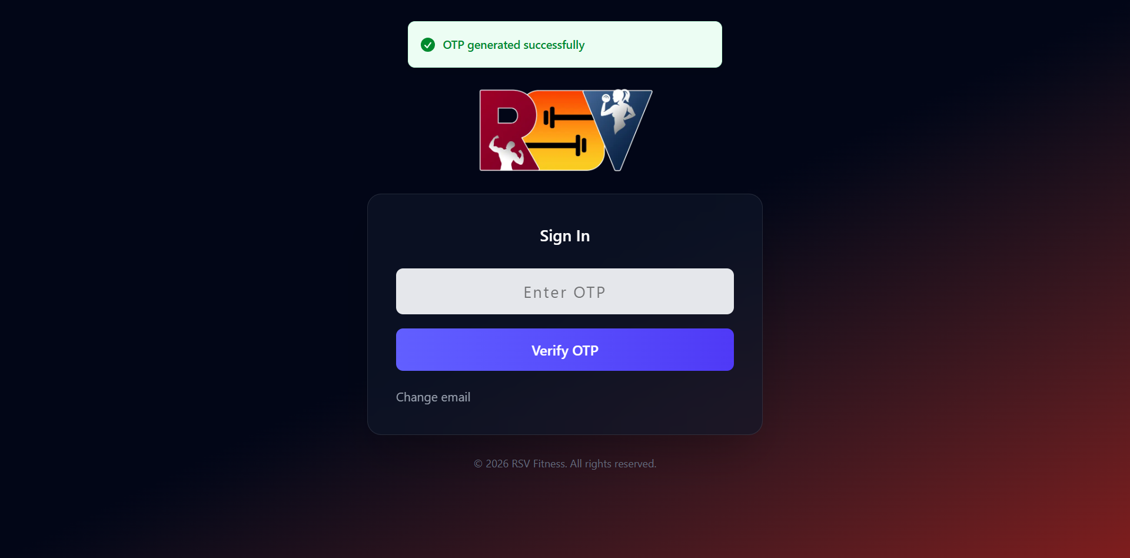
AUTHENTICATION SYSTEM
🔐 Sign In Screen
Secure OTP-Based Login
No passwords. Just your email.
RSV Fitness Studio uses a passwordless authentication system. Users enter their email, receive a one-time OTP, and gain role-specific access instantly — no passwords to remember or manage.
01
Enter Email Address
User enters their registered gym email ID
02
Receive OTP via Email
Secure OTP sent via Nodemailer to inbox
03
Verify & Login
OTP verified → JWT token issued instantly
04
Role-Based Redirect
Super Admin / Admin / Member portal loaded
JWT token validation • Role-based middleware • API route protection • Secure OTP handling • Rate limiting

Slide 4
ADMIN DASHBOARD
Complete Control at a Glance
📊 Admin Dashboard
All your gym data — live, in one view.
The Admin Dashboard is the command center of RSV Fitness Studio. It displays live KPIs, revenue analytics, traffic slot data, and membership expiry alerts — giving admins full situational awareness at all times.
99
98
Total Members
Active Members
₹54,966
0
Monthly Revenue
Today's Attendance
Revenue Analytics Chart —
6-month bar chart with growth trend
Expiring Memberships Panel —
30-day expiry alerts with one-click renewal notification
Daily Traffic Slots —
Morning / Noon / Evening slot attendance tracking
Recent Registrations Table —
Latest member signups with plan, amount & status
Live KPI tracking • Revenue analytics • Expiry alerts • Traffic monitoring • Recent registrations

Slide 5
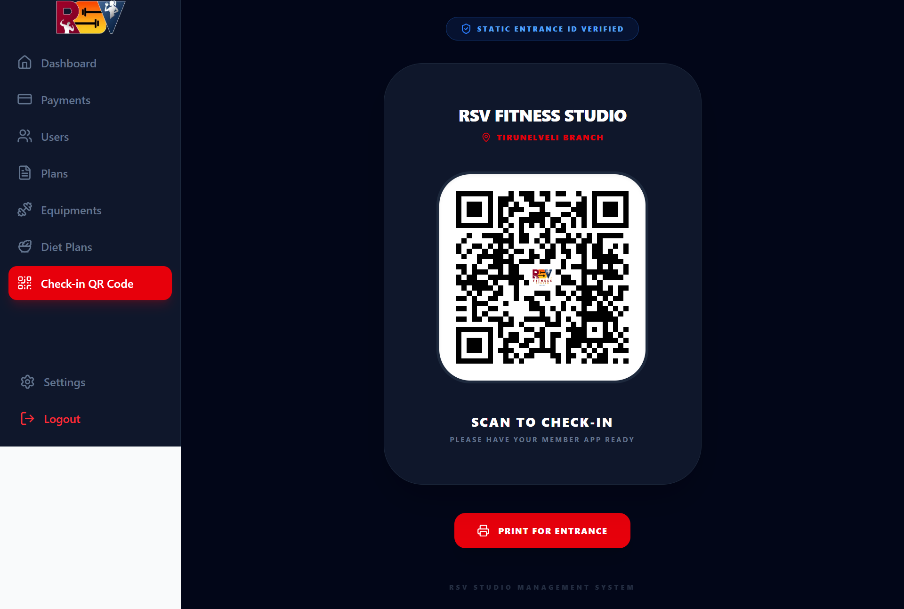
QR ATTENDANCE SYSTEM
Touchless QR Check-In
📱 Check-In QR Code Screen
No cards. No manual logs. Just scan.
Members scan the gym's unique QR code at the entrance using their RSV member app. The system instantly records their check-in, prevents duplicates, and logs everything securely.
01
Admin Generates QR
One unique QR code created per gym branch
02
Member Opens App
Launches RSV mobile member portal
03
Scans at Entrance
Camera scans the QR code displayed at door
04
Attendance Logged
Date, time & member ID recorded instantly
05
Duplicate Prevented
One check-in per member per day enforced
Attendance logs stored for 365 days • Auto-deletion via Netlify Scheduled Functions • Secure member data

Slide 6
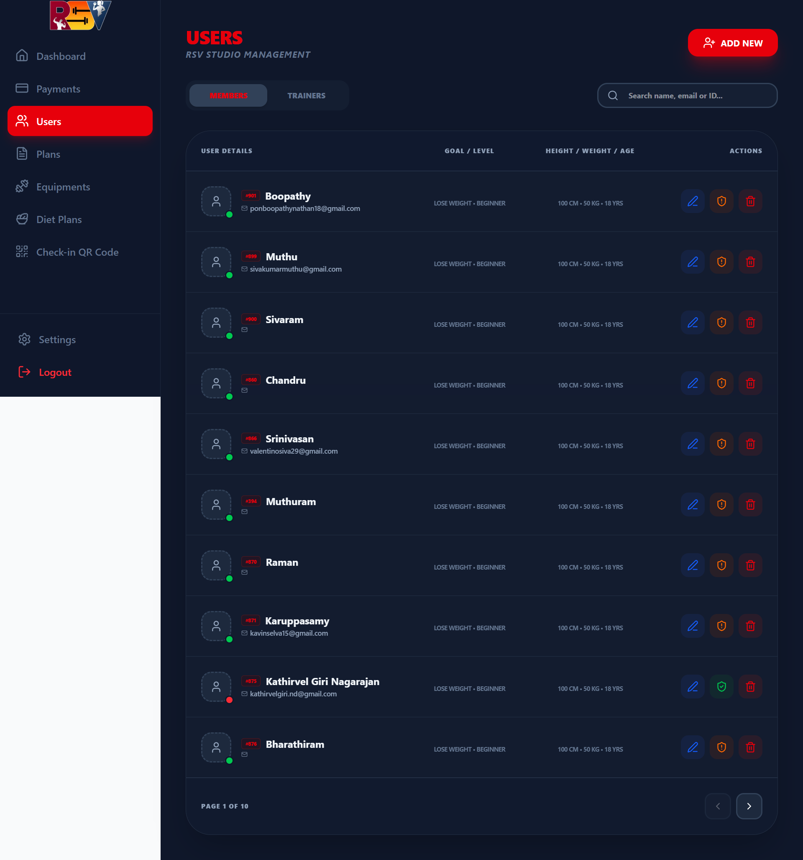
MEMBER MANAGEMENT
👥 Members / Users Screen
Full Member Lifecycle
Register, manage and track every member.
Admins have complete control over member records — from registration to renewal. Each member profile stores personal details, fitness goals, plan status, trainer assignment, and attendance history.
Register New Members
Name, email, phone, gender, plan, trainer, photo
Edit & Update Profiles
Modify any member detail at any time
Membership Status Tracking
Active / Expired / Pending Renewal badges
Search & Pagination
Search by name, email or member ID across 10+ pages
Trainer Assignment
Link each member to a dedicated trainer
Expiry Alerts & Renewal
Auto-flag members with memberships expiring soon
Admin only • Role-protected routes • Member + Trainer tabs • Full CRUD support

Slide 7
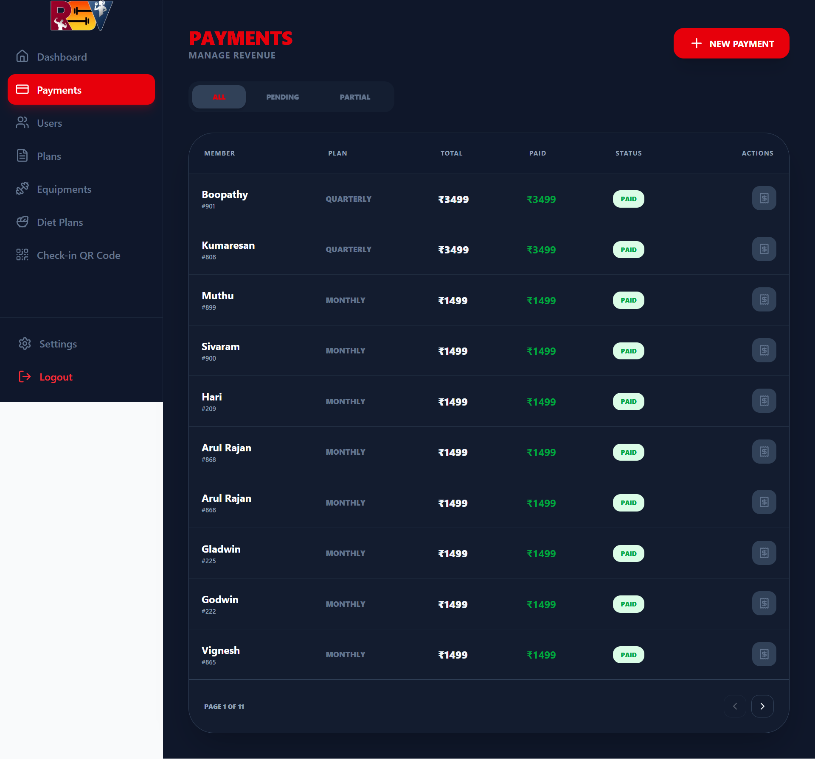
PAYMENT TRACKER
Revenue & Payment Tracking
💳 Payments Screen
Every rupee. Every plan. Every member.
The Payments module gives admins a complete view of all gym revenue — filterable by status (All / Pending / Partial). Generate PDF invoices on the spot and track renewal history per member.
💰 Payment Records
Member name, plan, amount paid, and status (PAID / PENDING / PARTIAL)
🧾 PDF Invoice Generation
One-click invoice download for any member payment
🔍 Status Filters
Filter by All, Pending, or Partial payment status
📄 Renewal History
Track each member's full payment history across plans
📊 Revenue Analytics
Monthly revenue integrated with the main dashboard charts
All amounts in ₹ INR • 11+ pages of payment records • PDF invoice download • Admin only

Slide 8
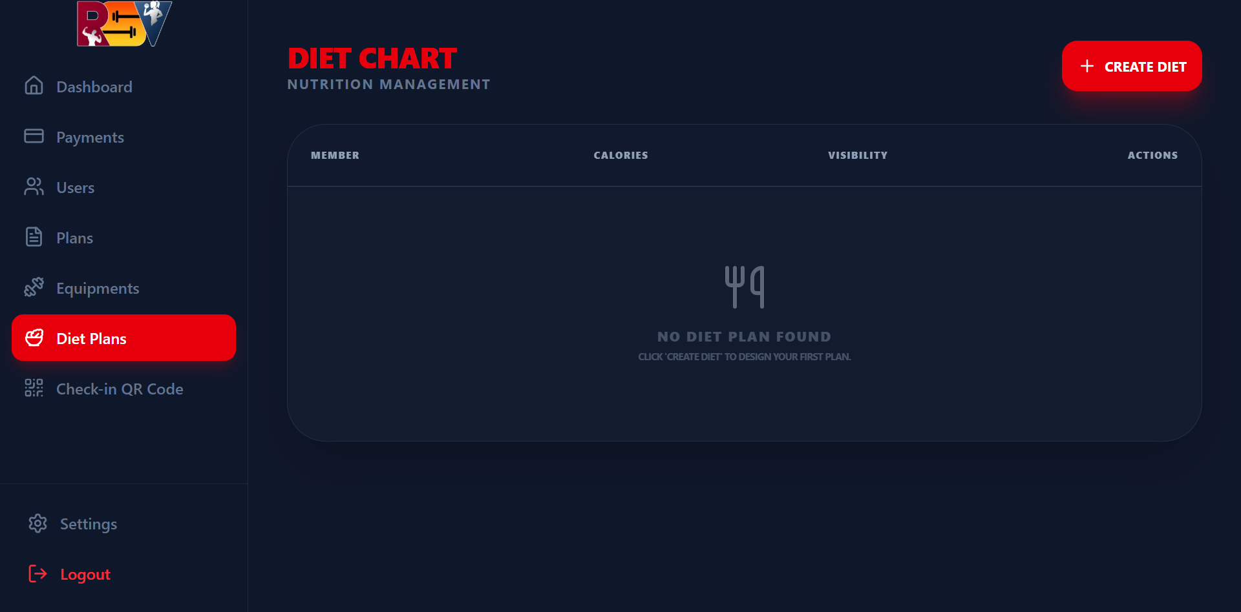
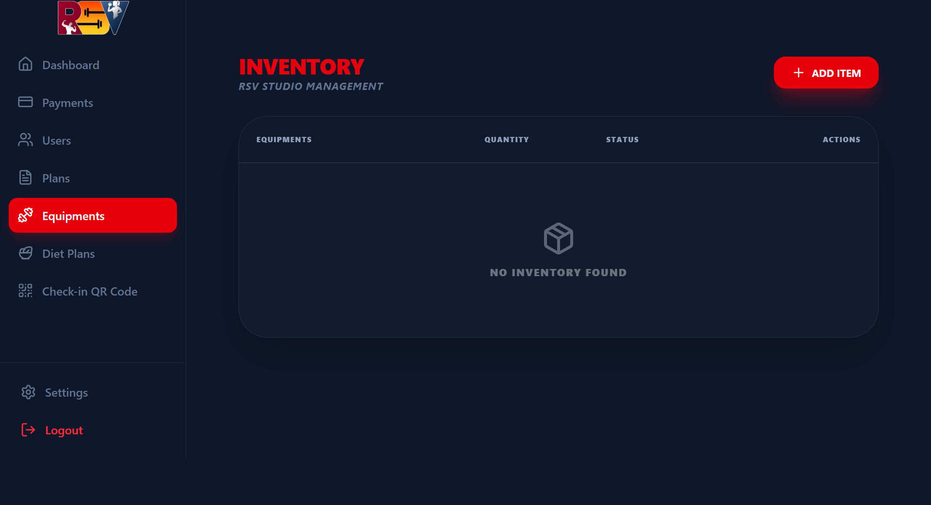
DIET & WORKOUT MANAGEMENT
🥗 Diet Chart — Nutrition Management
Wellness Plans & Equipment
Personalized nutrition, workouts & gear.
DIET CHART
Admin creates tailored diet plans per member
Calorie targets & meal-by-meal breakdown
Members can view & download their chart
Visibility control (show/hide from member)
WORKOUT CHART
Create weekly workout routines per member
🏋 Equipment Management
Assign exercise schedules (day-by-day)
Members view & track their routine
EQUIPMENT TRACKING
Track every piece of gym equipment
Status: Active / Under Maintenance / Replaced
Admin manages all plans • Members see only their own • Download as PDF • Full CRUD support

Slide 9
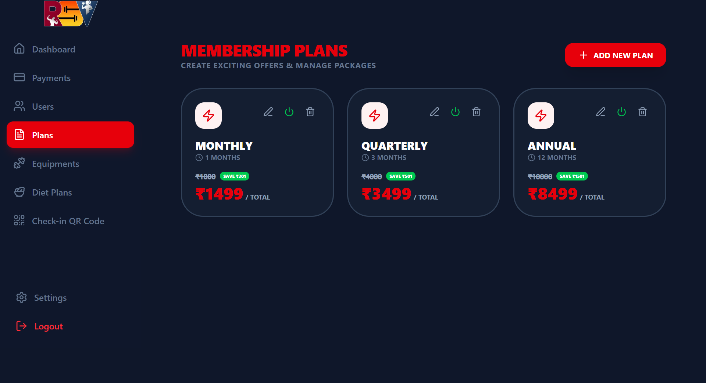
MEMBERSHIP PLANS
Flexible Membership Plans
📋 Membership Plans Screen
Monthly, quarterly & annual packages.
Admins can create, price, and manage multiple membership tiers. Each plan is configurable with its own duration, price, and features — making it easy to offer promotions and renewals.
Monthly
Quarterly
₹1,499
30 days
₹3,499
90 days
Half-Yearly
Annual
₹4,000
180 days
₹8,499
365 days
ADMIN PLAN FEATURES
Create & name custom plans • Set price & duration • Assign plans during member registration • Track active plan per member
Fully configurable by Admin • Multiple active plans supported • Tied to payment & member records

Slide 10
ANALYTICS & REPORTING
Data-Driven Gym Management
Insights that drive better decisions.
📅 Daily Analytics
📈 Weekly Trends
🗓 Monthly Reports
Per-day attendance counts & revenue
Week-over-week growth patterns
Full month summaries for planning
⚡ Lazy-Loaded Charts
💸 Revenue Tracking
🔔 Expiry Alerts
Optimised for Netlify Hobby limits
Track income per plan & per period
30-day renewal warning panel
Powered by Recharts • Dynamic imports • Lazy-loaded components • Optimized for performance

Slide 11
MULTILINGUAL • MOBILE-FIRST • AUTOMATION
Built for Everyone. Runs Everywhere.
Tamil, English, mobile, desktop — all covered.
🌐 English + Tamil
📱 Mobile-First Design
⚙️ Cron Automation
Full i18n support with next-intl
Responsive across all screen sizes
Netlify Scheduled Functions
Complete bilingual UI
Bottom navigation bar
Daily auto-cleanup
Every label, menu & message localised
Dedicated mobile nav for quick access
Attendance logs older than 365 days deleted
Language switcher
Touch-friendly UI
Expiry notifications
Toggle between EN and Tamil instantly
Large tap targets, swipe-optimized tables
Auto email alerts sent to expiring members
Examples
Responsive tables
Database efficiency
Dashboard → டாஷ்போர்டு
Members → உறுப்பினர்கள்
Payments → கட்டணங்கள்
Data tables adapt for small screens
Keeps MongoDB size within Hobby plan limits
i18n routing
QR scanner screen
Zero maintenance
next-intl with locale-based routing
Optimised camera scan interface for mobile
Fully serverless, no manual intervention needed
Dark & Light theme support • Glassmorphism UI • Smooth animations • Premium Fitness SaaS design

Slide 12



SECURITY & TECH STACK
Enterprise Security. Lean Architecture.
TECH STACK
Secure by design. Optimized for Netlify.
Frontend
Next.js App Router • TypeScript • TailwindCSS
Every layer of RSV Fitness Studio is security-hardened — from OTP auth and JWT tokens to middleware-protected routes, MongoDB sanitization, and rate limiting on all API endpoints.
Auth
JWT • OTP via Nodemailer • bcryptjs
JWT Authentication
Database
MongoDB • Mongoose ODM
Secure token generation & validation on every protected route
Deployment
Netlify Hobby • Serverless Functions
OTP via Nodemailer
Passwordless sign-in — no stored passwords, no leaks
Libraries
Recharts • React Hook Form • Zod • Lucide
Role-Based Middleware
Super Admin → Admin → Member — enforced at API level
Forms & UX
react-query • next-themes • next-intl
Rate Limiting & Sanitization
Features
QR Code Gen • i18n • Cron Cleanup
MongoDB query sanitization + API rate limits vs abuse
Env variable protection • HTTPS enforced • Middleware-protected routes • Production-ready

Slide 13
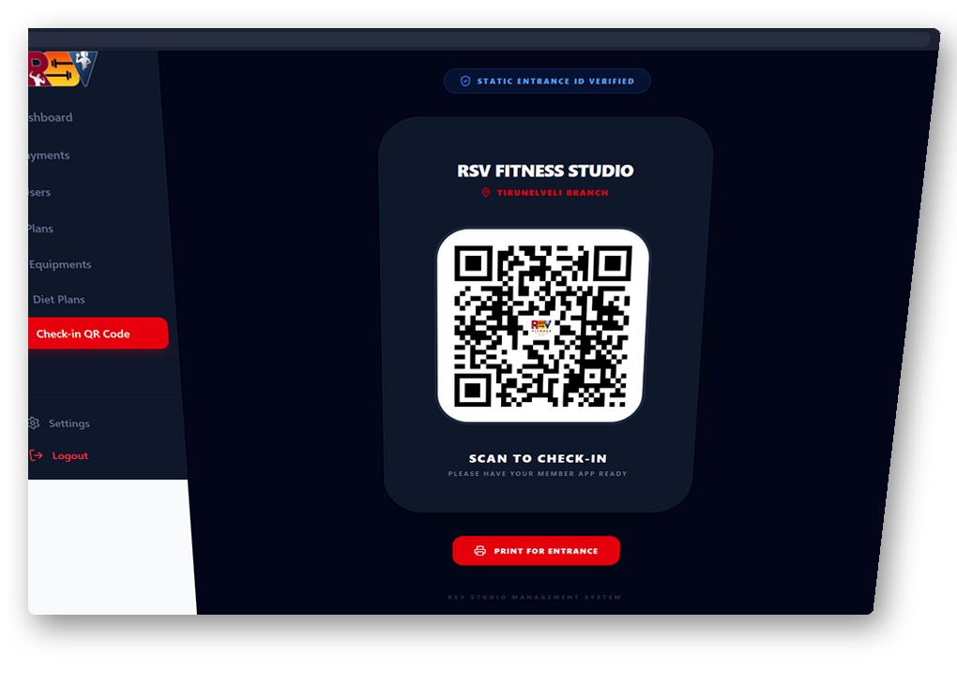
READY TO POWER
YOUR GYM?
RSV Fitness Studio is production-ready — a complete, secure, and scalable SaaS platform tailored for modern fitness centers.
Multi-role access: Super Admin, Admin, Member
QR-based contactless attendance system
Payment tracking with PDF invoice generation
Personalized diet & workout plan management
Revenue & membership analytics dashboard
Tamil + English bilingual support
Mobile-first responsive design
Netlify Hobby — optimized & production-ready
RSV FITNESS STUDIO — Gym Management SaaS • 2026 • Confidential Client Presentation

